Slide 1

DATA SCIENCE PROGRAMMING PROJECT
COMPILED BY:
SANIYA ISLAM
RAUSHAN kumar
ANOOP BHARADWAJ

Slide 2

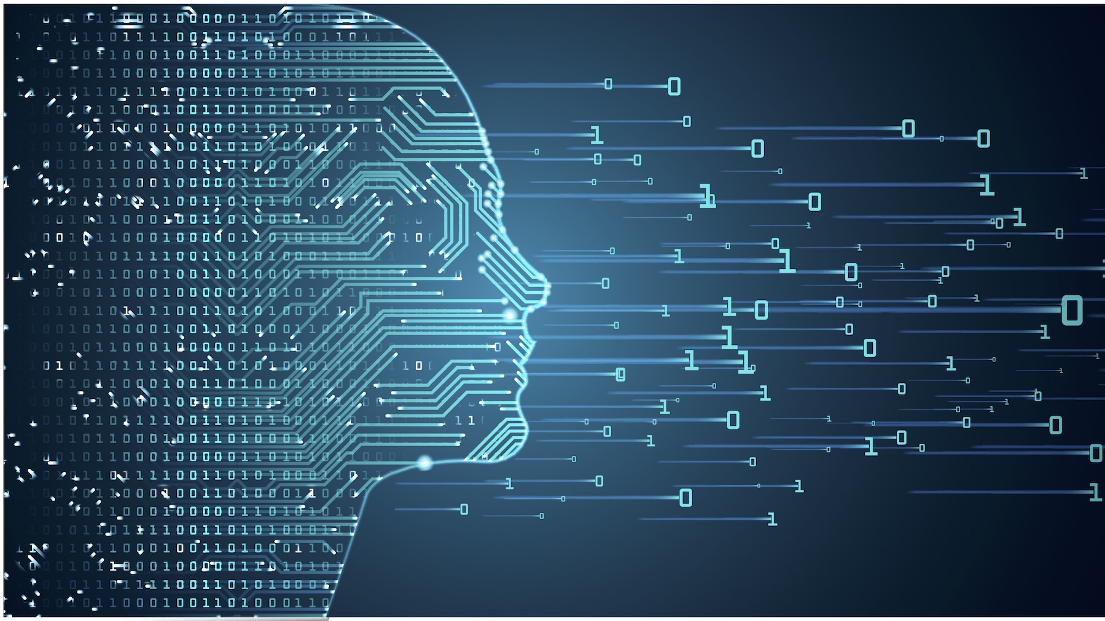
USF Logo recognition

Slide 3
agenda
Logo recognition in images has been gaining considerable attention in the last decade, with such applications as copyright infringement detection, intelligent traffic-control systems, and automated computation of brand-related statistics.

Slide 4
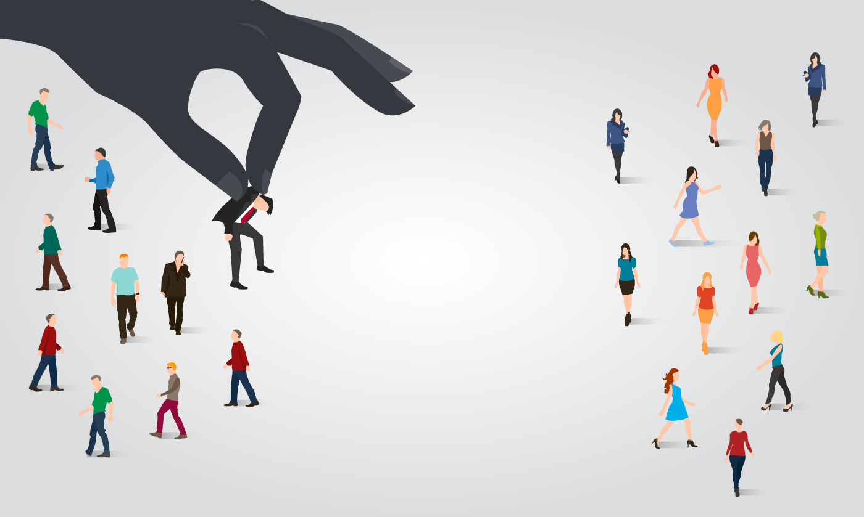
PROBLEM DEFINITION
Given a set of USF AND NON-USF images and prior knowledge about the content of the images IDENTIFY the correct image

Slide 5

APPROACH
1. GATHERING DATA
2. DATA PREPARATION
3. CHOOSING A MODEL
4. TRAINING
5. EVALUATION
6. PREDICTION

Slide 6
GATHERING DATA
1. gathered IMAGES FOR USF LOGOS
2. gathered IMAGES FOR OTHER COLLEGE LOGOS
3. gathered IMAGES FOR USF AS A TINY PART OF FULL IMAGE
4. gathered RANDOM IMAGES
5. Added noise in usf logos

Slide 7
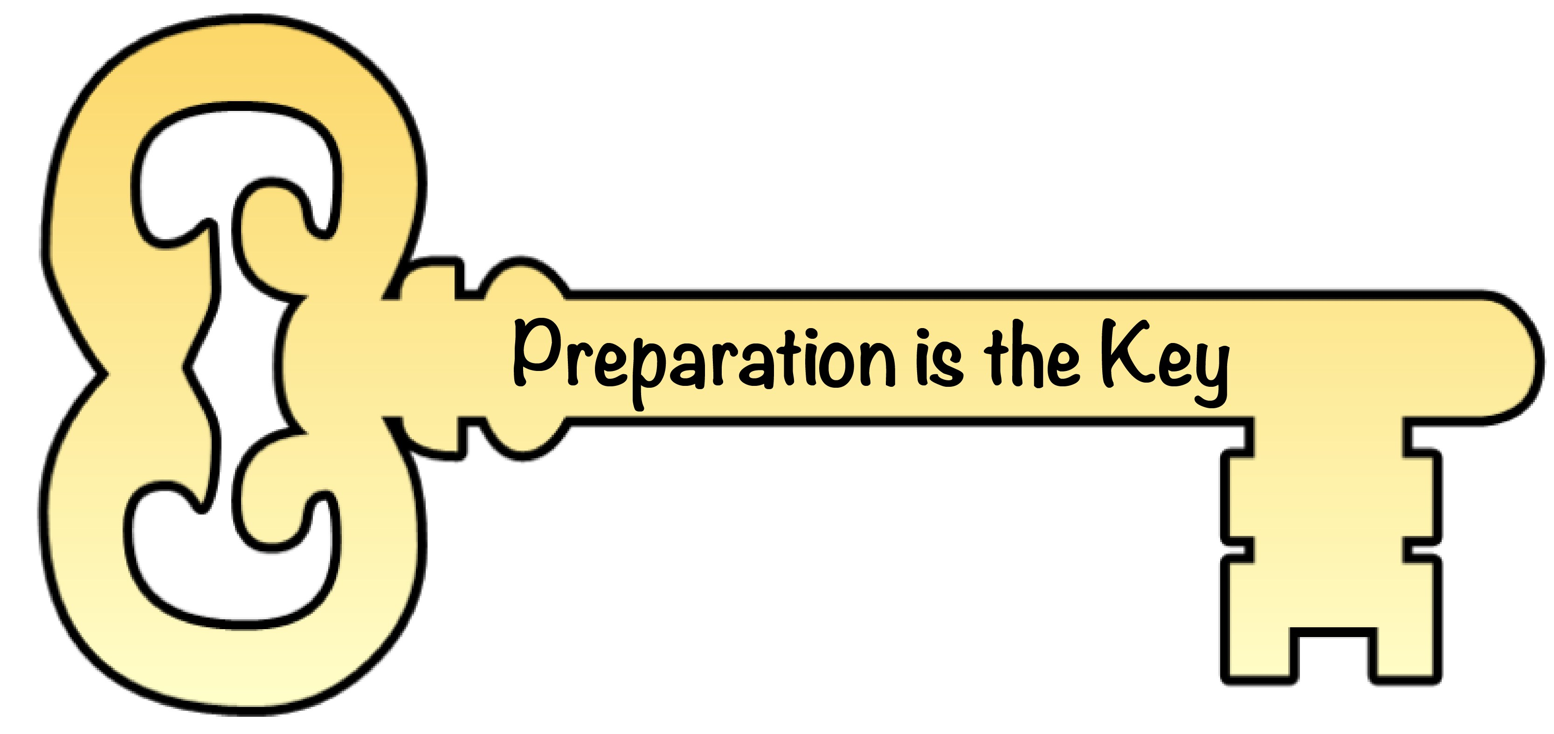
DATA PREPARATION
5 DATASETS CREATED (MERGING OF DATA)
1. USF AND NON-USF LOGOS (RATIO 200/100)
2. USF AND NON-USF LOGOS(RATIO 200/150)
3. usF AS TINY PART OF IMAGE AND RANDOM IMAGES
4. USF LOGO AND RANDOM IMAGES
5. USF LOGO WITH NOISE AND RANDOM IMAGES

Slide 8
transformation OF IMAGES (.JPG EXTENSION ONLY)
RENAMING OF IMAGES ACCORDING TO LABEL FILE
LABEL FILES CREATED FOR EACH DATASET
RESHAPING OF IMAGES from 3 DIMENSIONAL IMAGE TO 2 DIMENSIONAL IMAGE

Slide 9
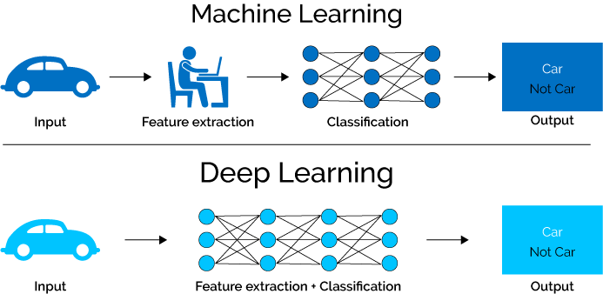
CHOOSING A MODEL
MACHINE LEARNING –
SGD CLASSIFIER
DEEP LEARNING –
CNN WITH Keras

Slide 10
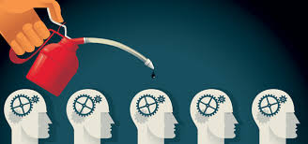
TRAINING
Shuffling of data .
Split the dataset into a separate train and test set.
Train data ratio is 80 and test data ratio is 20.

Slide 11

Machine learning

Slide 12



USF AND NON-USF LOGOS (RATIO 200/100)
Collected 200 images of usf logos
Collected 100 images of non-usf logos
Merged both of them and renamed them
Cleaned the data by converting all the files in .jpg
Reshaped the data into 28 * 28
Split the data in ratio of 80/20(train /test)
Used cross-validation (cv=3())

Slide 13


USF AND NON-USF LOGOS(RATIO 200/150)
Collected 200 images of usf logos
Collected 150 images of non-usf logos
Merged both of them and renamed them
Cleaned the data by converting all the files in .jpg
Reshaped the data into 28 * 28
Split the data in ratio of 80/20(train /test)
Used cross-validation (cv=3())

Slide 14


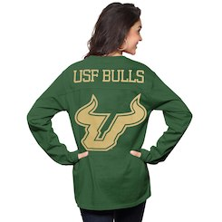

usF AS TINY PART OF IMAGE AND RANDOM IMAGES
Collected 200 images of usf logos as a tiny part of image
Collected 175 random images
Merged both of them and renamed them
Cleaned the data by converting all the files in .jpg
Reshaped the data into 28 * 28
Split the data in ratio of 80/20(train /test)
Used cross-validation (cv=3())

Slide 15
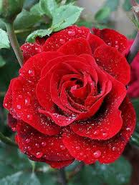

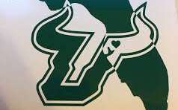
USF LOGO AND RANDOM IMAGES
Collected 200 images of usf logos
Collected 100 random images
Merged both of them and renamed them
Cleaned the data by converting all the files in .jpg
Reshaped the data into 28 * 28
Split the data in ratio of 80/20(train /test)
Used cross-validation (cv=3())

Slide 16
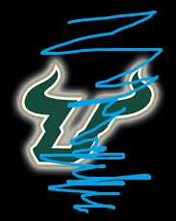
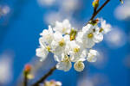

robustness USF LOGO WITH NOISE AND RANDOM IMAGES
Collected 200 images of usf logos
Added noise in the images by painting the edges or filling color
Collected 100 random images
Merged both of them and renamed them
Cleaned the data by converting all the files in .jpg
Reshaped the data into 28 * 28
Split the data in ratio of 80/20(train /test)
8. Used cross-validation (cv=3())

Slide 17
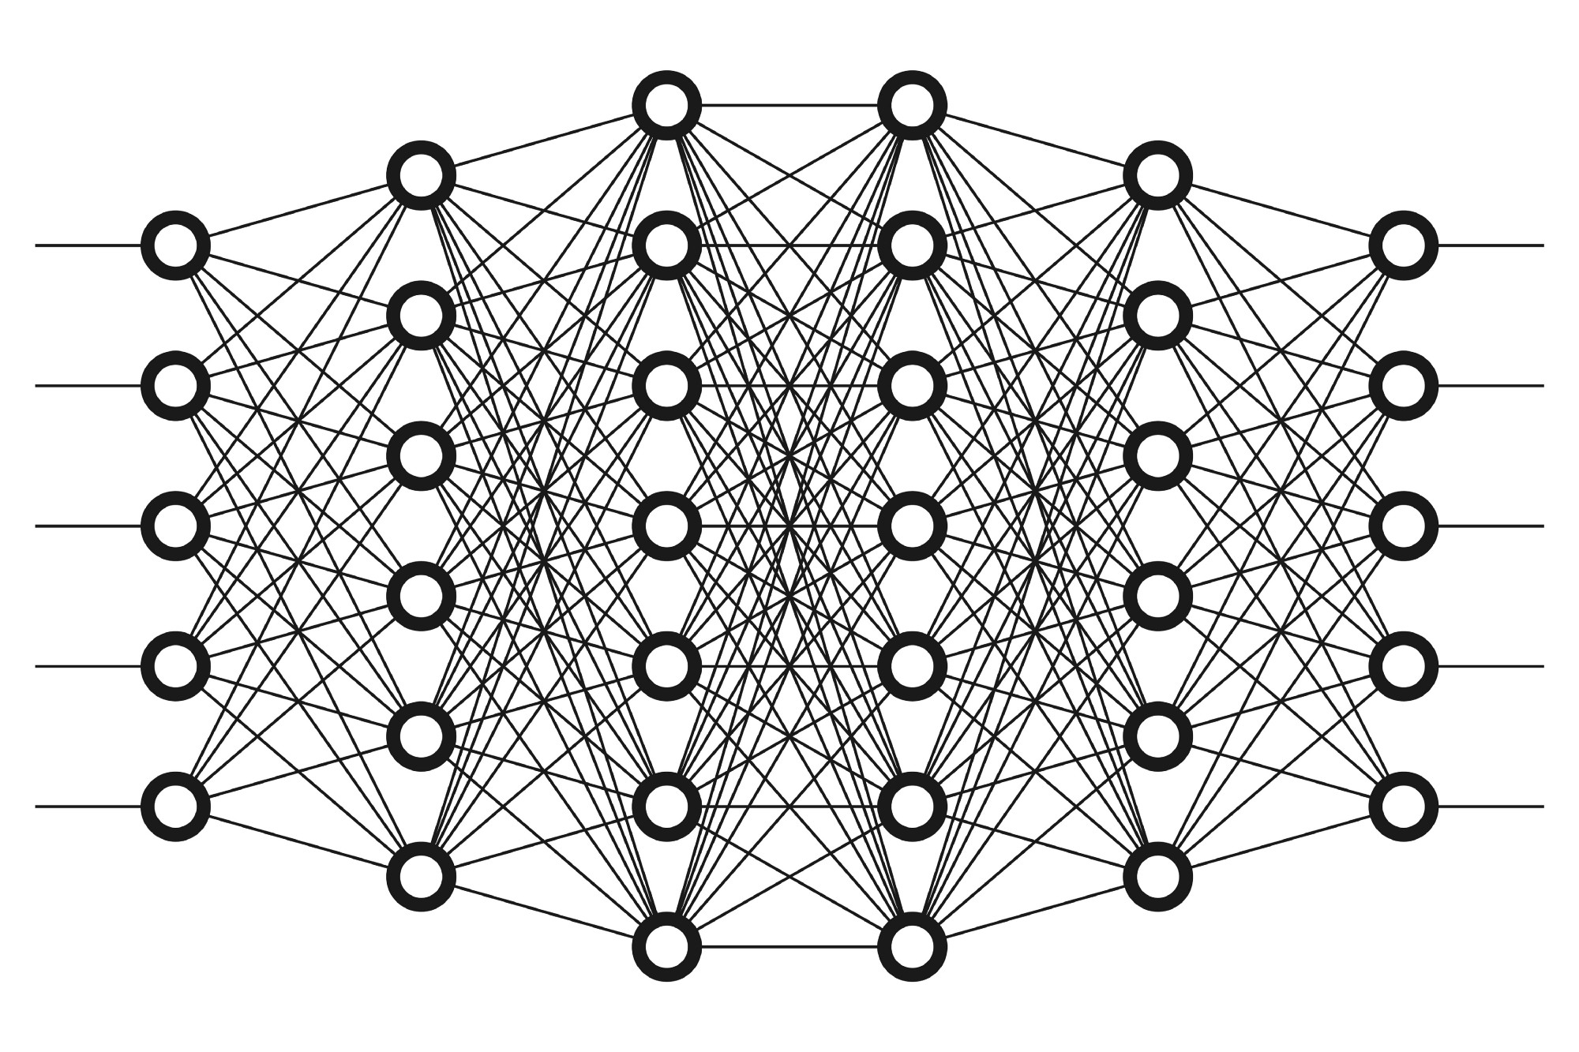
Deep learning

Slide 18
cnn
Package used –
keras
Layers –
convolution layers
max pooling layer
Model -
activation function (Relu)
flatten
dropout = 0.25

Slide 19
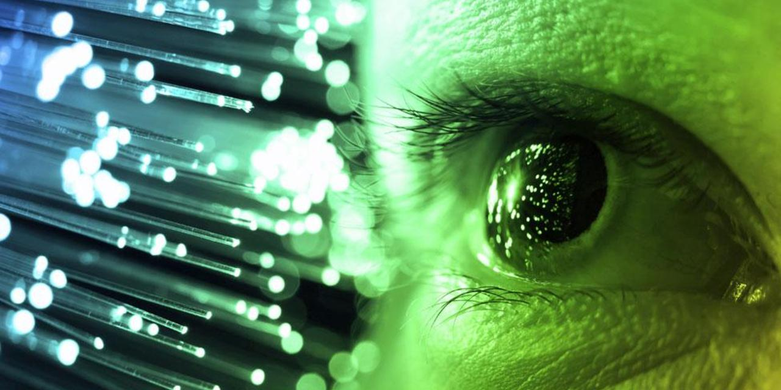
Future improvements
Add more images to the dataset
Add more noise to make the model robust
Increasing the no of layers
Fit the model

Slide 20


